Slide 1

Dept. of Cyber Forensics & Information Security MINI PROJECT REVIEW TITLE: An Experimental Analysis of DDoS Attack Detection and Response Supervisor: Dr. Gaurav Sharma Presented By: Tadikamalla Revanth Mahajan (NDU202500358)

Slide 2
CONTENTS
Abstract
Introduction
Literature Survey
Methodology
Objectives
System Design
Software Requirements
Hardware Requirements
Applications, Advantage and Disadvantage
Results
Conclusion
Future Scope
Reference

Slide 3
ABSTRACT :
DDoS (Distributed Denial of Service) attacks are one of the biggest threats to online services today. These attacks flood a server with huge amounts of fake traffic from many sources, making the server crash or become too slow for real users. In this project, I built a lab environment using virtual machines to simulate, detect, and stop a DDoS attack. We used tools like DDoSify to launch the attack, Wireshark and tcpdump to capture traffic, Snort to detect the attack, and fail2ban to automatically block the attacking IPs. This project helps understand how real world DDoS attacks work and how to defend against them.

Slide 4
INTRODUCTION :
The internet is used by millions of people every day for banking, shopping, communication, and more.
Attackers try to bring down websites and servers using DDoS attacks by sending massive traffic from many computers at once.
When a server is flooded with fake requests, real users cannot access the service this causes financial loss and damage to reputation.
Organizations need proper tools and techniques to detect these attacks early and respond quickly.
This project focuses on setting up a controlled lab, simulating a real DDoS attack, capturing and analyzing the traffic, and applying mitigation techniques.
The goal is to understand the full lifecycle of a DDoS attack from how it starts to how it is stopped.

Slide 5
LITERATURE SURVEY :
S.No | Title | Author / Year | Methodology Used | Drawbacks
1. | A Survey on DDoS Attack Detection and Prevention Methods | M. Bhuyan, D. Bhattacharyya, 2020 | Reviewed anomaly-based and signature-based detection across multiple IDS systems | No single method covers all attack types; survey lacks practical implementation
2. | Intrusion Detection System Using Snort for DDoS Mitigation | A. Ahmed & F. Khan, 2020 | Deployed Snort IDS with custom rules to detect SYN flood and HTTP flood attacks | Snort rules must be manually updated; cannot detect zero-day attacks
3. | Hybrid DDoS Defense: Combining IDS and Rate Limiting | J. Singh & P. Verma, 2022 | Combined Snort IDS + iptables rate limiting to reduce DDoS impact on web servers | Complex configuration; performance degrades under large-scale attacks
4. | Botnet-Based DDoS Attack Simulation in Virtual Environments | K. Zhao et al., 2020 | Used GNS3 and virtual machines to simulate multi-source botnet DDoS attacks | Simulation does not fully replicate real-world botnet behavior and scale
5. | Investigating DDoS Attack Mitigation Strategies and Simulation Tools Using GNS3 | Abdifatah Farah Samatar | Used GNS3-based virtual network to simulate DDoS attacks and evaluate mitigation techniques. | Limited scalability and realism compared to real-world large-scale botnet DDoS attacks.

Slide 6
OBJECTIVES OF PROPOSED MODEL :
To understand how a DDoS attack works in a real network environment.
To simulate a DDoS attack safely inside a virtual lab without affecting real systems.
To capture and analyze malicious network traffic using Wireshark and tcpdump.
To configure Snort as an Intrusion Detection System to identify DDoS patterns.
To implement fail2ban for automatic IP banning as a mitigation technique.
To study the effect of the attack on server performance (before and after mitigation).

Slide 7
METHODOLOGY :
Existing Solution :
1. Signature-Based Detection (Snort with default rules) Matches traffic against a fixed database of known attack signatures. Only works on attacks it already knows completely blind to new or modified DDoS patterns. Rules must be updated manually by the administrator.
2. Anomaly-Based Threshold Detection Sets a fixed number (e.g., max 100 requests per second per IP). Raises alert when crossed. The problem is that a real product launch or flash sale can also cross this threshold, causing false alarms. Tuning the threshold is difficult and varies by use case.
3. Manual IP Blocking via iptables Admin reads logs manually, identifies attacker IPs, and writes firewall rules. Very slow by the time the admin acts, the server has already been down for several minutes. Completely fails against distributed attacks from thousands of different IPs.
4. Passive Traffic Logging Only (tcpdump alone) Records all packets into a file. Useful for forensics after the attack, but provides zero protection during the attack. There is no alerting, no detection, and no automated response.
5. Standalone IDS (No Response Integration) Tools like Snort in detection-only mode can identify the attack but cannot block anything. An alert is only useful if someone is watching the console. At night or on weekends, attacks go unblocked.

Slide 8
METHODOLOGY :
Proposed Solution :
proposed model integrates simulation, capture, real-time detection and automated response into one end-to-end pipeline using open-source tools running on virtual machines.
Stage 1 Attack Simulation DDoSify is used on the attacker VM (Kali Linux) to launch a controlled HTTP flood around 2000 requests with 200 concurrent connections against the victim machine (Ubuntu Server running Apache). This simulates a real-world application-layer DDoS attack in a safe environment.
sudo apt-get update
sudo apt-get install ddosify (for installation)
./ddosify -t http://<Victim-IP> -n 2000 -c 200 (Attack command)
Stage 2 — Traffic Capture tcpdump runs passively on the monitoring VM and captures all packets flowing through the virtual network into a pcap file. This provides raw evidence and supports post-attack forensic analysis without impacting the victim machine.
sudo apt-get update
sudo apt-get install wireshark tcpdump (for installation)
sudo tcpdump -i eth0 -w ddos-attack.pcap (capture live packets from network)
Stage 3 — Traffic Analysis Wireshark is used to open the pcap file and visually analyze traffic. The IP addresses generating the most connections are identified using Wireshark's Statistics Conversations view. This confirms which sources are responsible for the flood.
wireshark ddos-attack.pcap (Analyze Traffic)

Slide 9
Stage 4 — Real-Time Detection Snort is configured with DDoS-specific detection rules and runs in IDS mode on the monitoring machine. It reads live traffic off the network interface and generates console alerts as soon as it detects patterns matching the configured rules providing real-time visibility.
sudo apt-get update
sudo apt-get install snort (Install snort)
sudo nano /etc/snort/snort.conf (configuration of snort)
alert tcp any any -> <Victim-IP> 80 (msg:"DDoS HTTP Flood Detected"; flow:to_server; threshold:type both, track by_src, count 100, seconds 10; sid:1000001; rev:1;) (writing snort rules)
sudo snort -A console -q -c /etc/snort/snort.conf -i eth0 (run snort)
Stage 5 — Automated Mitigation fail2ban is installed on the victim machine and configured to monitor Apache's access log. When any single IP exceeds 300 requests in a 300-second window, fail2ban automatically creates an iptables rule to ban that IP for 1 hour without any admin involvement.

Slide 10
sudo apt-get update
sudo apt-get install fail2ban - (install fail2ban)
sudo nano /etc/fail2ban/jail.local
[http-get-dos]
enabled = true
port = http,https
filter = http-get-dos
logpath = /var/log/apache2/access.log
maxretry = 300
findtime = 300
bantime = 3600 – (configuration)
sudo systemctl restart fail2ban – (restart service) detects excessive requests from single IP, blocks using IP tables, bans for 1hour, provides automatic mitigation
Why this model improves on existing approaches: Combines both detection (Snort) and automated response (fail2ban) in one pipeline. Eliminates manual IP blocking delays. Provides forensic evidence (Wireshark and tcpdump) even after the attack ends.

Slide 11
DDOSIFY SIMULATION PARAMETERS :
Attack Parameters | Definition
Target URL / IP | http:// (victimip)
Attack Type | HTTP Flood (Layer 7)
Number of Requests (-n) | 2000
Concurrency Level (-c) | 200
Number of Trials | 10–120
Protocol | HTTP / TCP/ DNS
Request Method | GET / POST
Attack Strategy | Low rate / Burst / Random
Rate Limiting | Requests per second control
Source (Attacker) | Kali Linux
Target System | Ubuntu Server
Monitoring Tools | Wireshark / Tcpdump / Snort
Metrics Observed | Response Time, Throughput, Packet Loss

Slide 12
DATA SET COMPARASION :
Comparison of the Canadian Institute for Cybersecurity (CIC) SYN Flood Attack 2017 CSV (syn.csv) with p.cap file generation in monitoring vm machine using wire shark enables us to know the scientific validation with real attack and simulator generator attack.
Feature | DDoS PCAP (HTTP Flood using DDoSify) | CIC-DDoS2017 PCAP (SYN Flood)
Attack Type | HTTP Flood | SYN Flood
OSI Layer | Application Layer (L7) | Transport Layer (L4)
Main Protocols | HTTP + TCP | TCP
Traffic Behavior | Full request-response cycle | Only SYN packets sent repeatedly
TCP Handshake | Completed (SYN → SYN-ACK → ACK) | Not completed (only SYN)
Packet Pattern | HTTP GET/POST requests | Continuous SYN packets
Wireshark Filter | http | tcp.flags.syn==1 && tcp.flags.ack==0
Packet Rate | High but structured | Extremely high and bursty
Example Tool Used | DDoSify | Dataset (pre-captured attack traffic)
Defense Mechanism | Rate limiting, fail2ban | SYN cookies, firewall rules

Slide 13
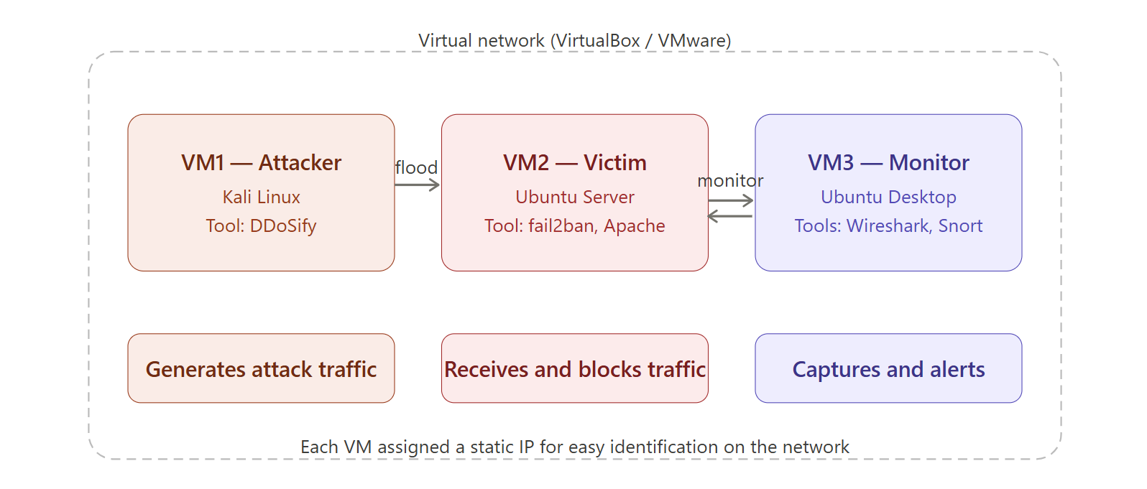
SYSTEM DESIGN :

Slide 14
SOFTWARE REQUIREMENTS :
Software | Purpose | Version
Kali Linux | Attacker OS | Latest
Ubuntu Server | Victim OS | 22.04 LTS
Ubuntu Desktop | Monitoring OS | 22.04 LTS
DDoSify | DDoS simulation tool | Latest
Wireshark | Packet analysis (GUI) | 3.x
tcpdump | Packet capture (CLI) | Latest
Snort | Intrusion Detection System | 2.9.x
fail2ban | Automatic IP banning | Latest
Apache2 | Web server on victim | 2.4.x
VirtualBox / VMware | Virtualization platform | Latest

Slide 15
HARDWARE REQUIREMENTS :
Component | Minimum | Recommended
RAM | 8 GB | 16 GB
Processor | Intel i5 / AMD Ryzen 5 | Intel i7 / Ryzen 7
Storage | 20 GB free | 50 GB free
Network | Single NIC(Network interface card) with virtual network | Dual NIC
OS (Host) | Windows 10 / Ubuntu 20.04 | Ubuntu 22.04

Slide 16
APPLICATIONS :
Used by cybersecurity professionals to test the resilience of their servers.
Can be used by network administrators to tune IDS rules and firewall settings.
Helps SOC (Security Operations Center) teams practice and understand incident response.

Slide 17
ADVANTAGES :
Provides hands-on practical experience with real tools used in the industry.
Entire setup is inside virtual machines no risk to real production systems.
Combines detection and automated response in a single pipeline.
Open-source tools no licensing cost required.
Easy to reproduce and scale for different attack scenarios.

Slide 18
DISADVANTAGES :
The lab is isolated does not reflect the complexity of real-world internet traffic.
fail2ban relies on log files if the log format changes, detection may fail.
Snort requires manual rule updates it cannot detect brand-new attack types on its own.
High RAM usage running 3 VMs simultaneously can slow down low-end machines.
DDoSify simulates a simple HTTP flood more advanced DDoS types (botnet) are not covered.

Slide 19
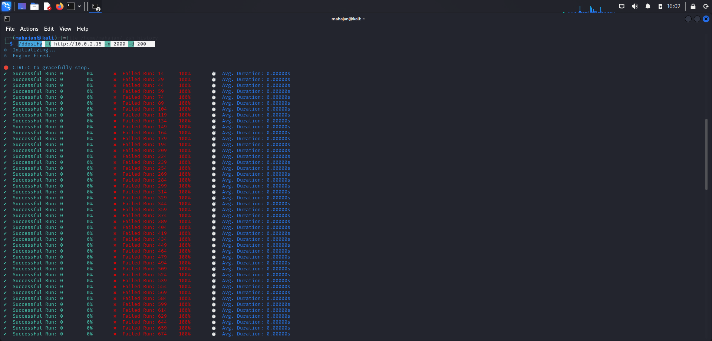
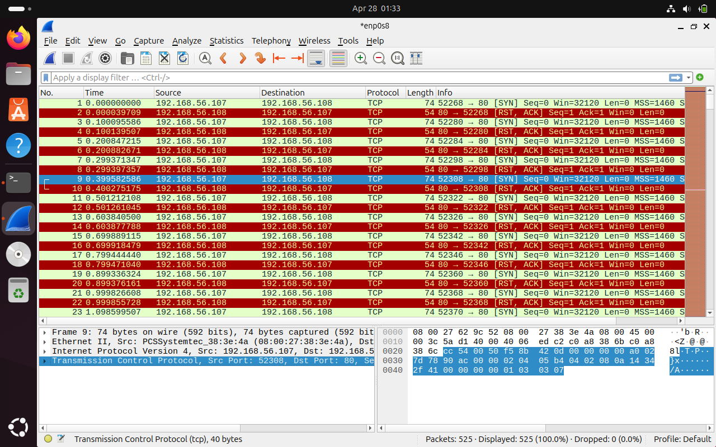
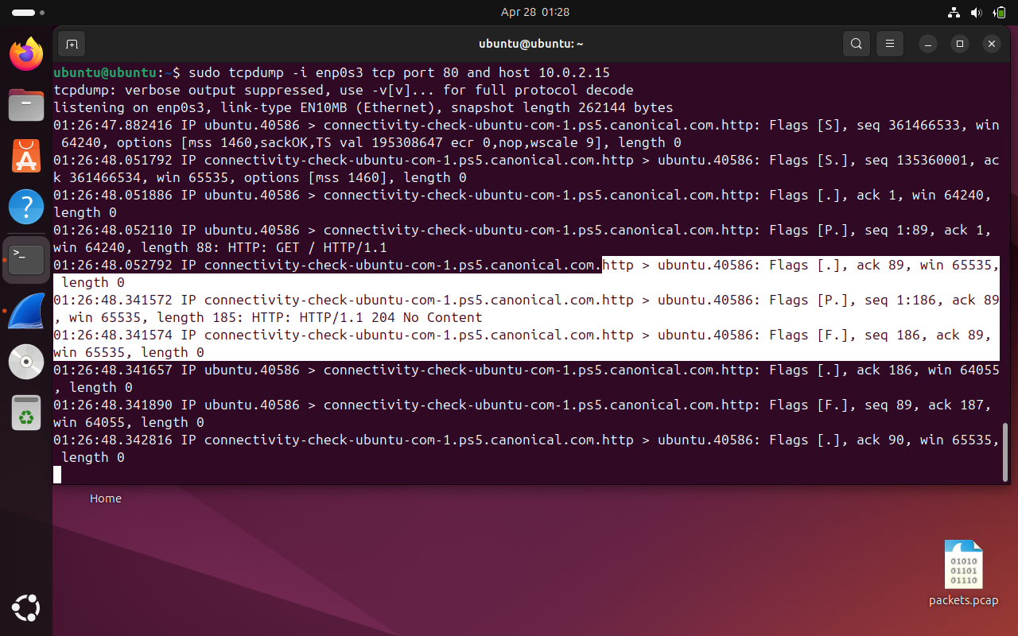
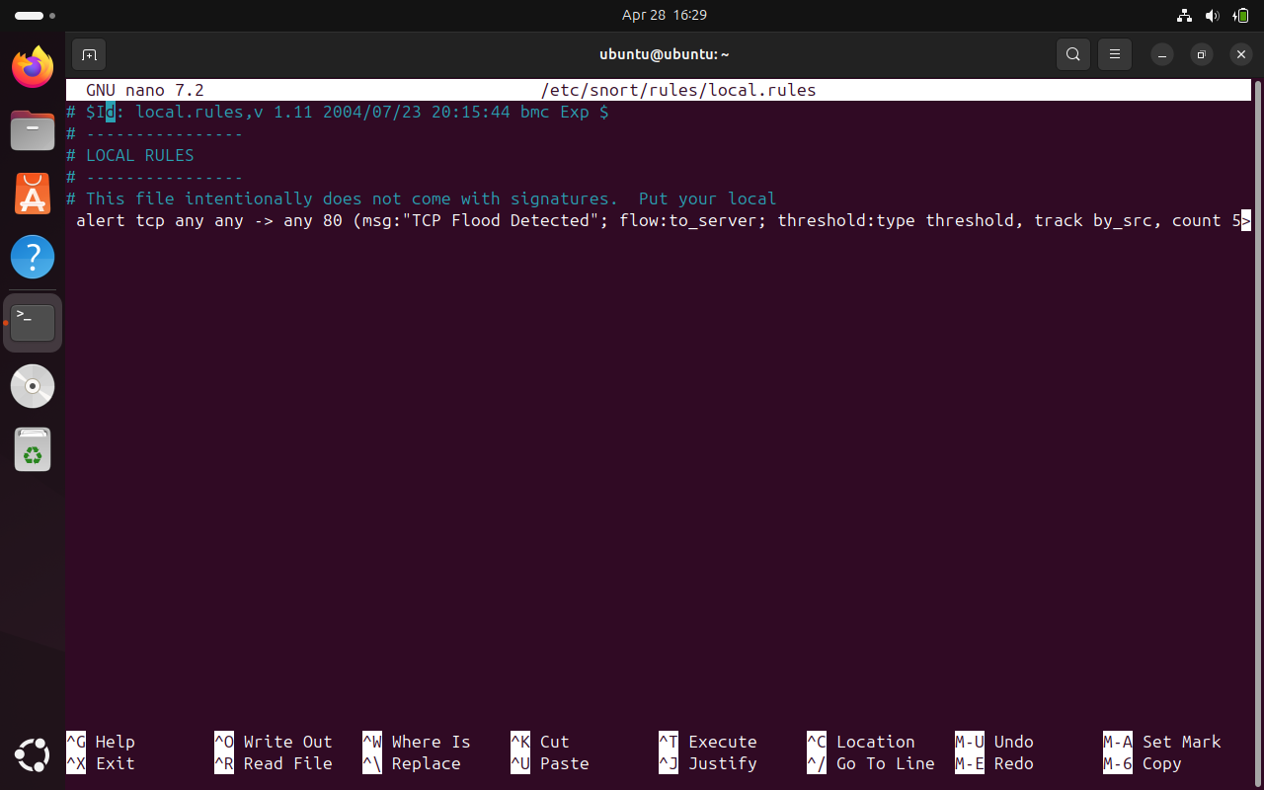
Results :

Slide 20
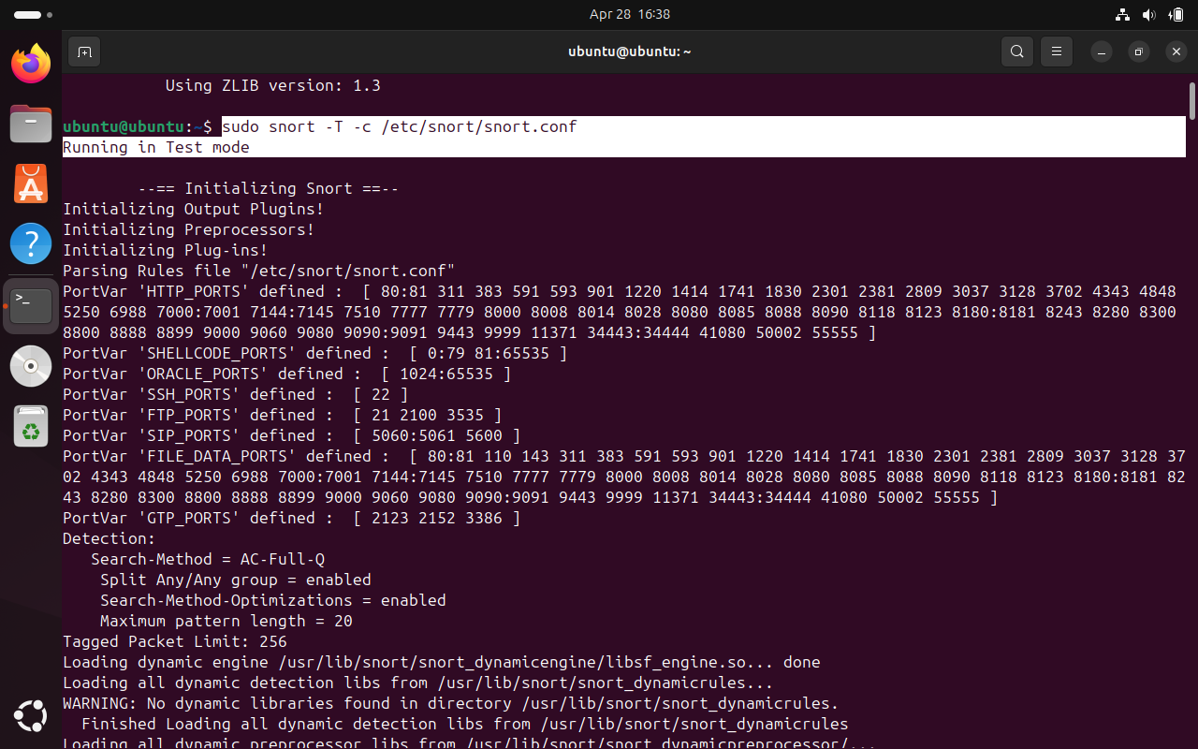
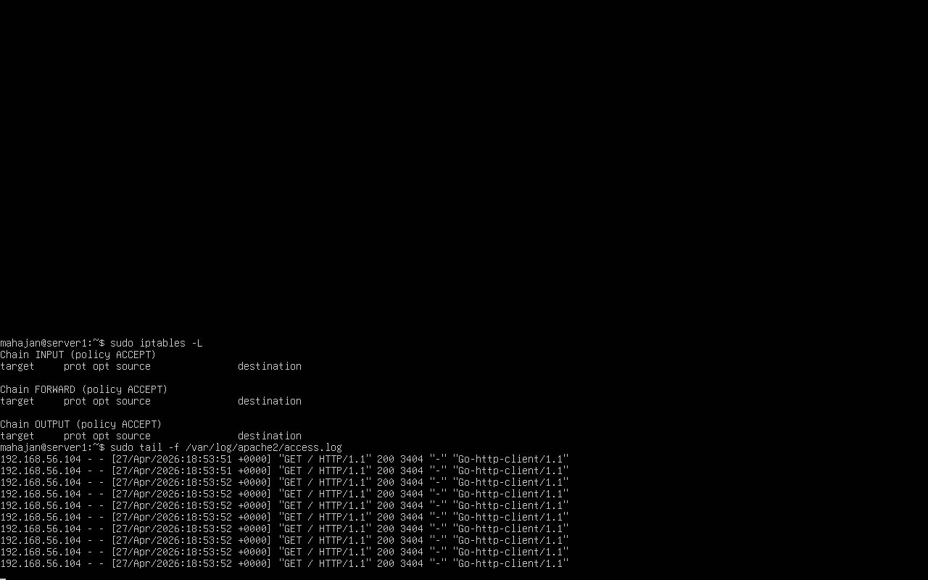
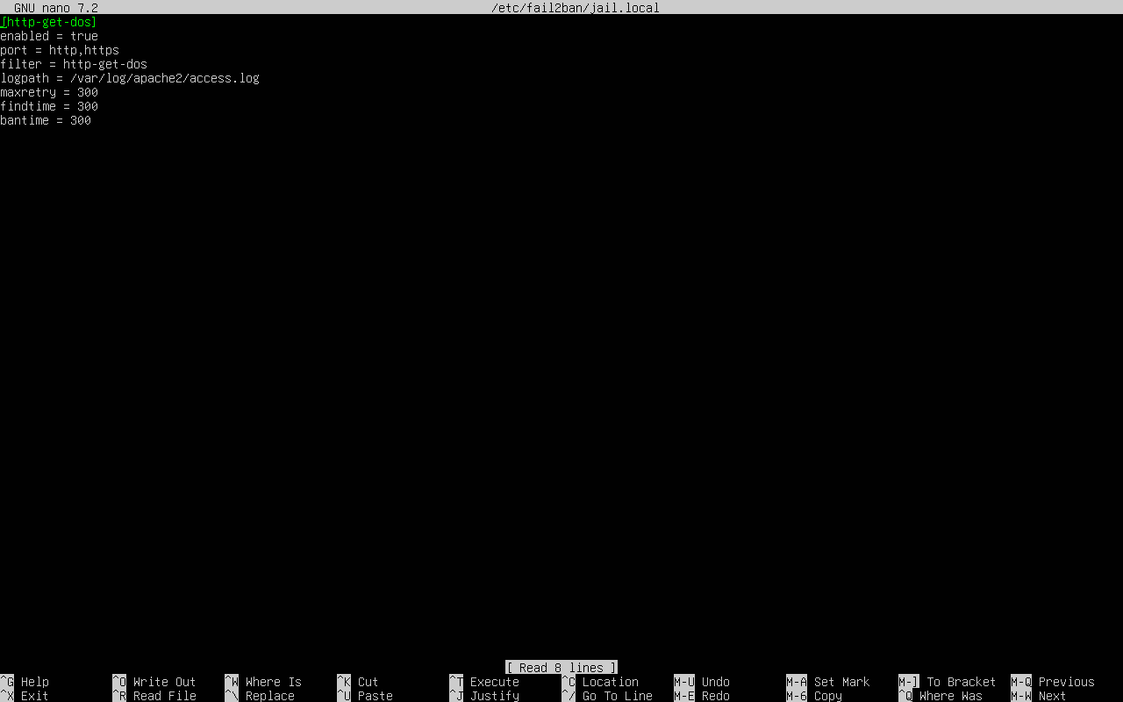
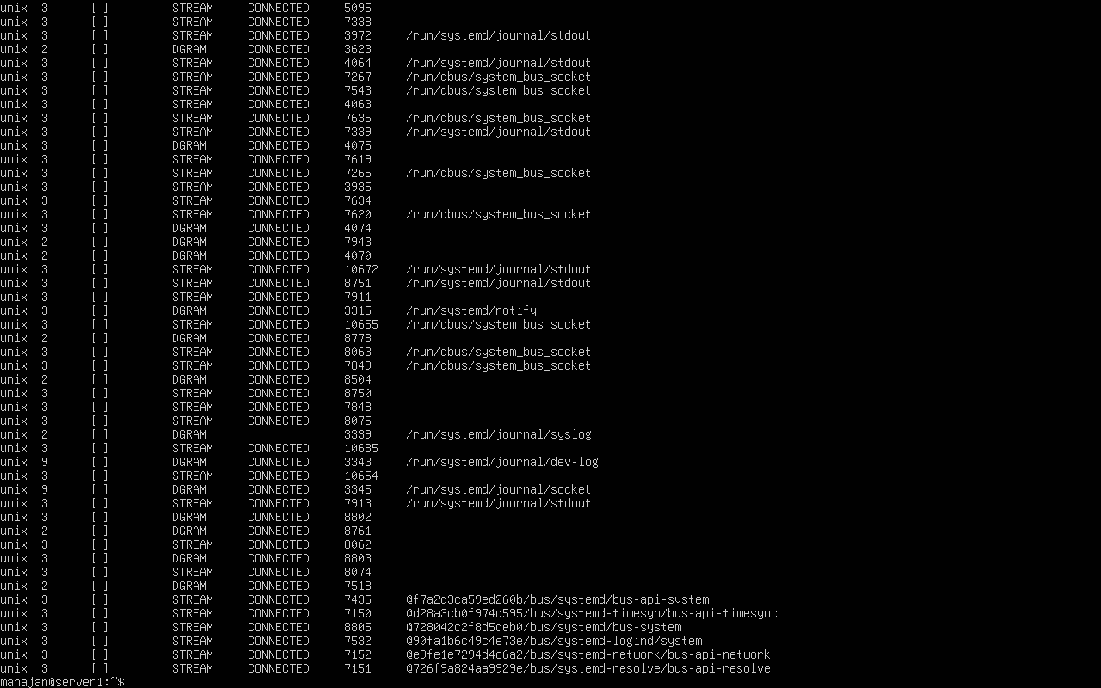

Slide 21
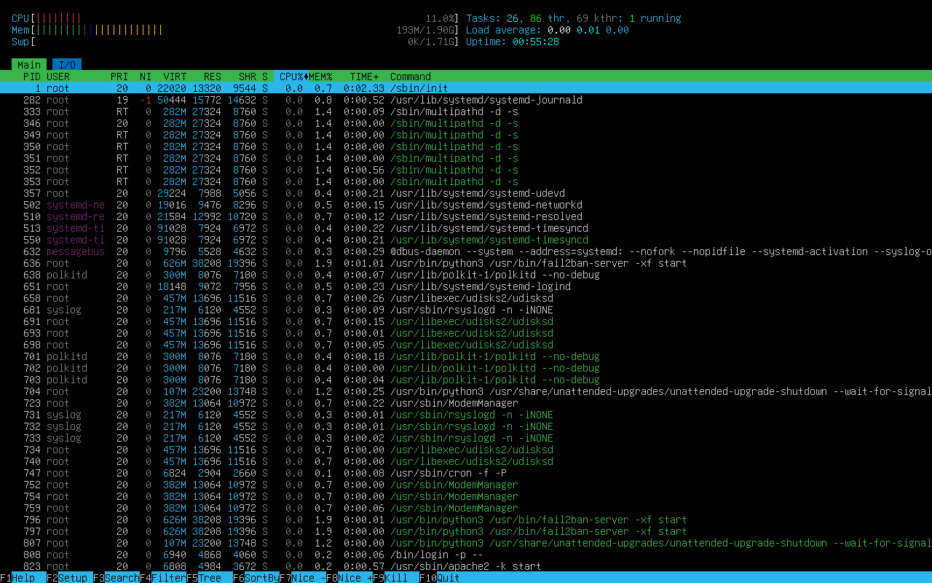
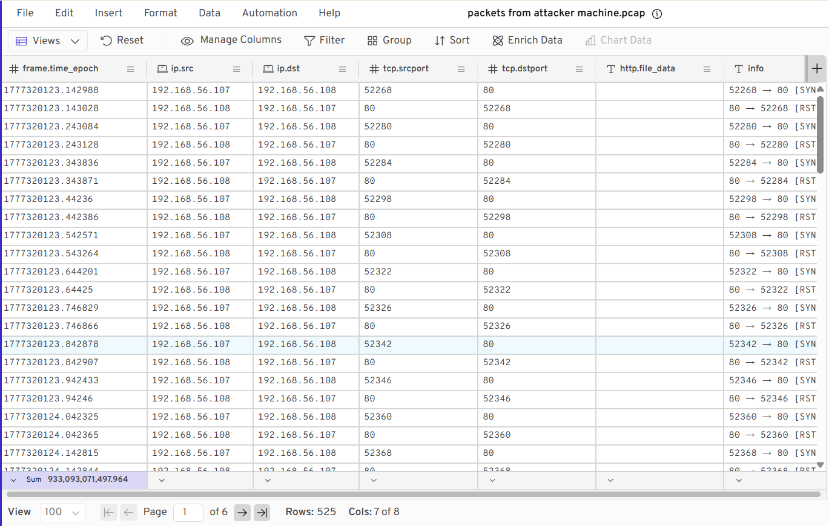
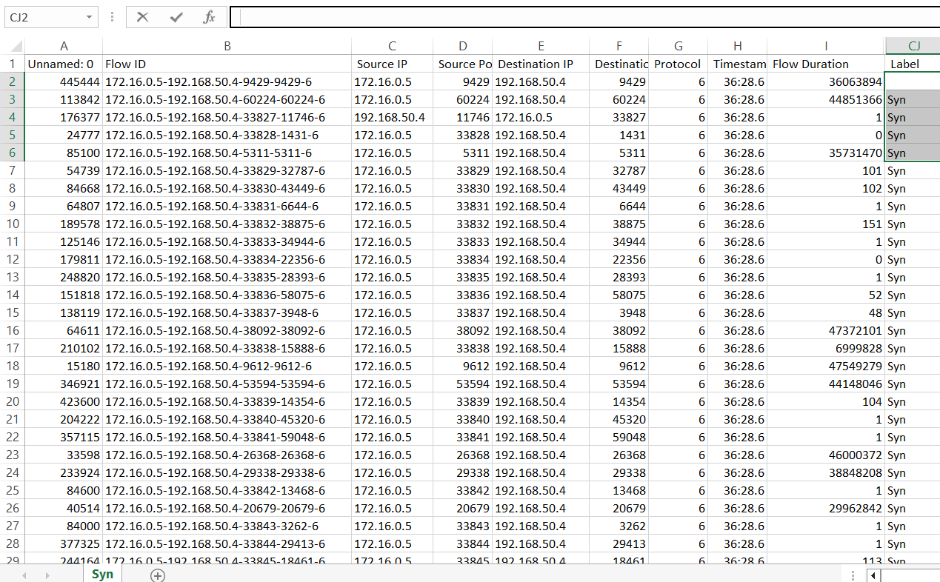

Slide 22
LIMITATIONS :
Isolated Lab Environment The entire setup runs inside virtual machines on a single host computer. Real-world DDoS attacks come from thousands of distributed sources across different countries and ISPs. The simulation uses just one attacker machine, which does not reflect the full complexity of an actual botnet-driven attack.
Snort Cannot Detect Zero-Day Attacks — Snort works by matching traffic against a set of pre-written rules. If a new type of DDoS attack is launched that does not match any existing rule, Snort will not raise any alert. Rules must be manually updated each time a new attack pattern is discovered.
No IPv6 Support — The entire lab is configured using IPv4 addressing. Modern networks increasingly use IPv6, and many DDoS attacks now originate from IPv6 addresses. Our current detection and mitigation rules do not cover IPv6 traffic.
,
High Resource Usage Running three virtual machines simultaneously requires at least 8GB RAM and a powerful CPU. On low-end machines, the VMs become slow, which reduces the reliability of the packet capture and affects the timing of fail2ban's response.

Slide 23
CONCLUSION :
This project successfully demonstrated how a DDoS attack is launched, detected, and mitigated in a controlled virtual environment.
By this Project I learned that no single tool is enough a combination of packet capture, IDS, and automated banning gives the best protection.
Snort proved effective at detecting abnormal traffic patterns, while fail2ban provided automated and fast response.
The project builds a strong foundation for understanding real-world network security operations.
It shows that even with basic open-source tools, a functional DDoS detection and mitigation system can be built.

Slide 24
FUTURE SCOPE :
Machine Learning-based Detection Train ML models on traffic data to detect attacks more accurately and reduce false positives.
Botnet Simulation Extend the lab to simulate attacks from multiple attacker machines (actual botnet behavior).
Cloud-based Mitigation Integrate with cloud services like AWS Shield or Cloudflare for large-scale protection.
Real-time Dashboard Build a web dashboard that shows live traffic, Snort alerts, and banned IPs visually.

Slide 25
REFERENCES :
[1] Bhuyan, M. H., & Bhattacharyya, D. K. (2020). A survey on DDoS attack detection and prevention methods. International Journal of Network Security, 22(3), 450–465.
[2] Ahmed, A., & Khan, F. (2020). Intrusion detection system using Snort for DDoS mitigation. International Journal of Computer Applications, 176(25), 15–21.
[3] Singh, J., & Verma, P. (2022). Hybrid DDoS defense: Combining intrusion detection systems and rate limiting techniques. Journal of Information Security and Applications, 64, 103056.
[4] Zhao, K., Li, X., & Chen, Y. (2020). Botnet-based DDoS attack simulation in virtual environments. IEEE Access, 8, 123456–123467.
[5] Samatar, A. F., Hirsi, A., Omar, A. M., & Abdiaziz, M. J. (2024). Investigating DDoS attack mitigation strategies and simulation tools using GNS3. In Proceedings of the 2024 International Conference on Electrical Engineering (FORTEI-ICEE) (pp. 142–147). IEEE. https://doi.org/10.1109/FORTEI-ICEE64706.2024.10824613

